Slide 1
Lecture 11
Copy constructor
Anonymous class
Lambda expression

Slide 2
Professional Java coding

Slide 3
Calling a methods by a created object
public static void main(String[] args) {
Student std1 = new Student("ali", 20);
std1.displayData( );
Student copyOfStd = new Student( ).copyObject(std1);
// Student copyOfStd= new Student( );
// copyOfStd.copyObject(std1);
copyOfStd.displayData( );
} }
class Student {
String name;
int age;
public Student( ){
}
public Student(String name, int age){
this.name = name;
this.age = age;
}
public Student copyObject (Student std) {
this.name = std.name;
this.age = std.age;
return std;
}
public void displayData( ){
System.out.println("Name : "+this.name);
System.out.println("Age : "+this.age);
}}
Name : ali
Age : 20
Name : ali
Age : 20

Slide 4
Passing an object to a method called by
another object
public static void main(String[] args) {
product A = new product(262);
product B = new product (487);
A.increase(B);
System.out.println(A.price);
System.out.println(B.price);
}
public class product {
int id;
int price;
public product (int n){
this.id= n;
price= 100;
}
public void increase (product p1){
p1.price+= 100;
this.price += 200;
}
}
300
200

Slide 5
Passing an object to a method called by
another object
public static void main(String[] args) {
product A = new product(262);
product B = new product (487);
A.increase(B);
System.out.println(A.price);
System.out.println(B.price);
}
public class product {
int id;
int price;
public product (int n){
this.id= n;
price= 100;}
public void increase (product p1){
p1.price+= 100;
this.price += 200; }}
Main
increase
Main method called increase by A and with parameter B
A
100
this
300
B
100
p1
200

Slide 6
Copy constructor
public static void main(String[] args) {
Employee m1= new Employee();
m1.id= 300;
m1.name= "Ahmed";
Employee m2= new Employee(m1);
System.out.println (m1.id);
System.out.println (m2.id);
m2.id=400;
System.out.println (m1.id);
System.out.println (m2.id);
}
class Employee {
int id;
String name;
Employee( ){
}
public Employee (Employee employee) {
this.id = employee.id;
this.name = employee.name;
}
}
300
300
300
400

Slide 7
Anonymous class
Java anonymous class is an class without a name.
only a single object is created.
It is useful when making an instance of an object with certain "extras" such as overloading methods of a class or interface, without having to actually subclass a class.

Slide 8
Anonymous class
public static void main(String[] args) {
A a =new B();
a.print();
}
}
public static void main(String[] args) {
A a =new A( ){
void print ( ){
System.out.println( "Inside B");}
};
a.print( );
}
class A{
void print ( ){
System.out.println( "Inside A");
}
}
class B extends A {
void print ( ){
System.out.println( "Inside B");
}
}
class A{
void print ( ){
System.out.println( "Inside A");
}
}

Slide 9
Anonymous class in Abstract class
abstract class Person{
abstract void eat();
}
class TestAnonymousInner{
public static void main(String args[]){
Person p=new Person( ) {
void eat(){System.out.println("nice fruits");}
};
p.eat();
} }
A class is created, but its name is decided by the compiler, which extends the Person class and provides the implementation of the eat() method.

Slide 10
Anonymous class implementing Interface
interface Eatable{
void eat( );
}
public static void main(String args[]){
Eatable e=new Eatable( ) {
public void eat(){System.out.println("nice fruits");}
};
e.eat();
}

Slide 11
lambda expression
Lambda expressions are similar to methods, but they do not need a name Java lambda expression is consisted of three components.
Argument-list: It can be empty or non-empty as well.
2) Arrow-token: It is used to link arguments-list and body of expression.
3) Body: It contains expressions and statements for lambda expression.
(p1,p2,…) -> { …….}

Slide 12
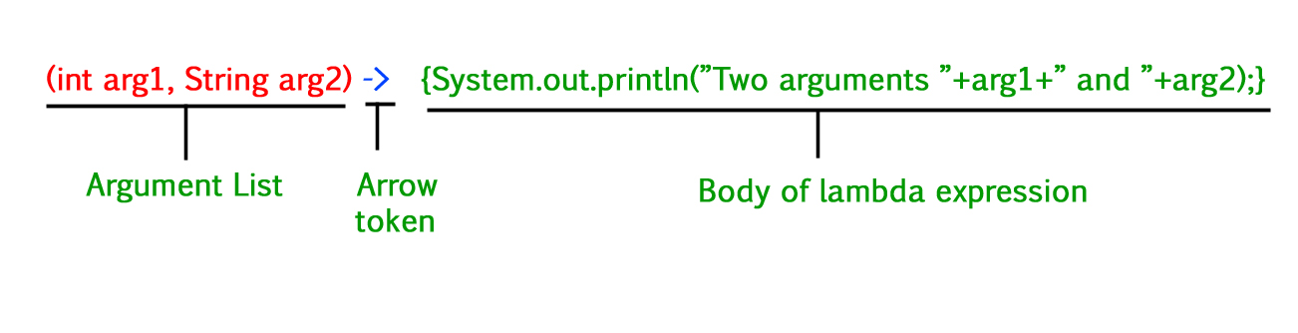
lambda expression
Traditional method
Return type Method name (Arguments) { implementation}

Slide 13
lambda expressions
are commonly used with interfaces
interface Functional {
int operation(int a, int b);
}
public class Test {
public static void main(String[] args) {
Functional add = (a, b) -> a + b;
Functional multiply = (a, b) -> a * b;
System.out.println(add.operation(6, 3));
System.out.println(multiply.operation(4, 5));
}
}
9
20

Slide 14
UML diagrams
1. Class Diagram
2. Sequence diagram

Slide 15
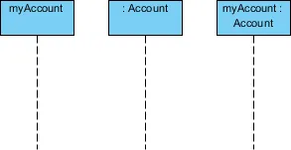
object
An object in a sequence diagram is drawn as a rectangle containing the name of the object.
An object can be named in one of three ways:
the object name, class name or object name and its class
Lifeline
A lifeline is represented by dashed vertical line drawn below each object.

Slide 16
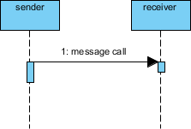
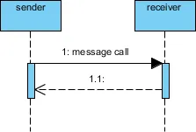
1.A synchronous message (typically an operation call) is shown as a solid line with a filled arrowhead. It is a regular message call used for normal communication between sender and receiver.
1.1 A return message uses a dashed line with an open arrowhead.

Slide 17
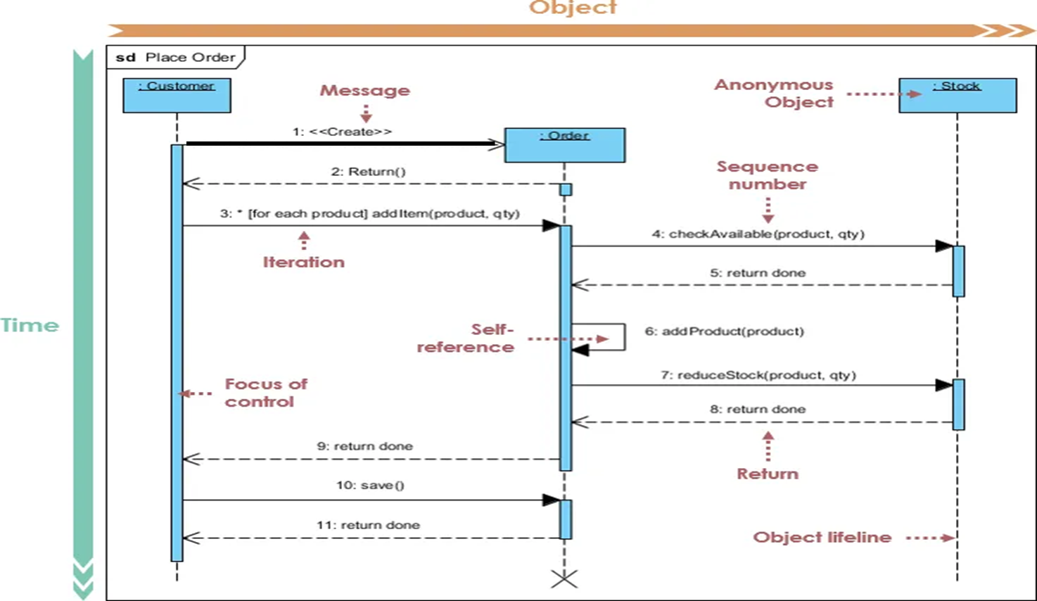
Sequence diagram for an online system consists of three classes (Customer, order, stock)

Slide 18
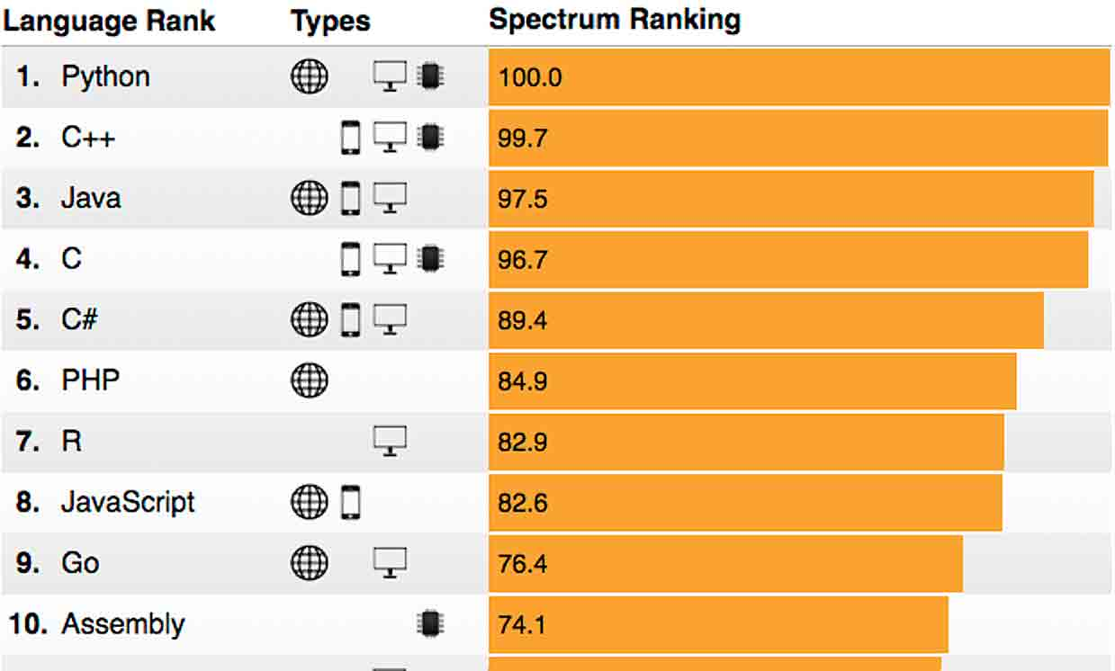
Why C++
C++ ranks 2nd in popularity according to 2024 IEEE spectrum Top Programming Language ranking.
Middle level programming language, allowing developers to achieve high performance.
Small object code size
(solve memory problems)
Facilities to write the same operation in different ways.

Slide 19
C++ Characteristics
Fully compiled language (changed from high level codes to machine code)
Can directly manipulate the hardware (or machine) that it runs on, run efficiently in any environment, even when there’s limited hardware space or energy available to power the application.
This translates to applications that run quickly and reliably on a variety of devices, making C++ ideal for forming the base layer of many important applications.

Slide 20
What is C++ used for?
Operating systems: MacOS, Unix and Windows to mobile operating systems like iOS.
Game development: Unreal engine uses C++
Web browsers: Google Chrome, Mozilla Firefox, Safari, and Opera.
Google search engine: relies on C++ to make sure that search results show up quickly and with minimal response time.
IoT devices: Controlling Embedded systems

Slide 21
Structure of C++ program
#include <iostream>
using namespace std;
int main()
{
cout << "Hello World!";
}
# include :to be able to use iostream library.
std is a standard namespace used in C++.
main function is the starting point of a C++ application
cout is an object of standard output stream
(Monitor)
"Hello World!“ is a string identified by “ “

Slide 22
Variable definitions
int x;
int x=5;
int x (5); Just like a constructor
int x {5};
Just like Java code

Slide 23
Namespace
It is a location in which the variable names, function names is declared
In huge programs Namespace is a location to store variables to avoid the confusion between names ( two variables may have the same name).
C++ uses many libraries, to avoid (having 2 variables with the same name C++ uses namespace.
A namespace is a form of scope in C++ that holds its own definitions for variables, functions.
cout and cin are defined inside of std namespace.

Slide 24
Using namespace allows you to deal with variables in the name space. “cout” is defined in standard library std
Two ways to deal with cout
#include <iostream>
int main()
{
std :: cout << "Hello World!";
}
#include <iostream>
using namespace std;
int main()
{
cout << "Hello World!";
}

Slide 25
Scope of the variables :: associated to global
#include <iostream>
int value(5); // global variable
int main()
{
int value = 7; // hides the global variable value
value ++ ; // increments local value, not global value
:: value -- ; // decrements global value, not local value
std::cout << "global value: " << ::value << "\n"; // 4
std::cout << "local value: " << value << "\n"; // 8
return 0; }

Slide 26
Scope of Variables
#include <iostream>
using namespace std;
namespace first
{
int val = 500; // Variable created inside namespace
}
int val = 100; // Global variable
int main()
{
int val = 200; // Local variable
cout << first::val << '\n';
cout << ::val << '\n';
cout << val << '\n';
return 0;
}
500
100
200

Slide 27
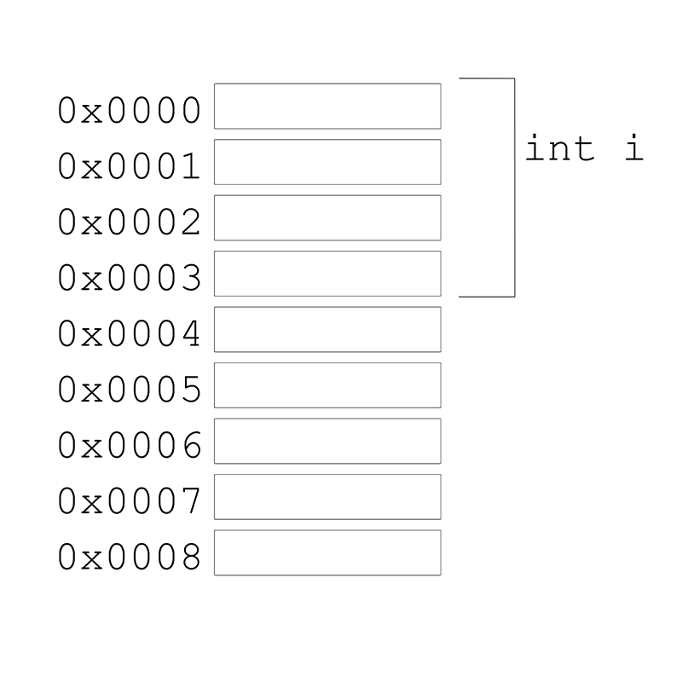
Memory is byte addressable
Byte address

Slide 28
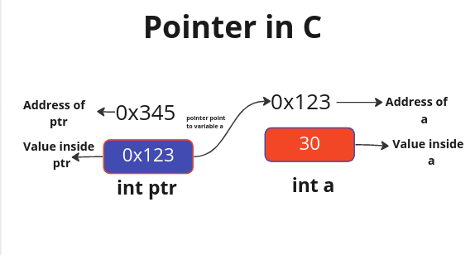
Pointers in C language
A pointer is a variable whose value is the address of another variable.
A pointer is a direct address of the memory location.
Like any variable or constant, you must declare a pointer before using it to store any variable address.

Slide 29
Pointers Declaration
int *x; ( pointer to an integer)
double *y; (pointer to a double )
float *z; (pointer to a float )
char *c; ( pointer to a character )
Here, type is the pointer's base type; it must be a valid C++ data type
var-name is the name of the pointer variable.
The asterisk * used to declare a pointer.

Slide 30
Pointer Initialization
Declaration:
int a; ( a is an integer)
int *pa; (pa is a pointer to integer)
int a = 2; ( a value =2)
int* pa = &a; (pa containing the address of a )
“&” operator means “address of” read it as “at”

Slide 31
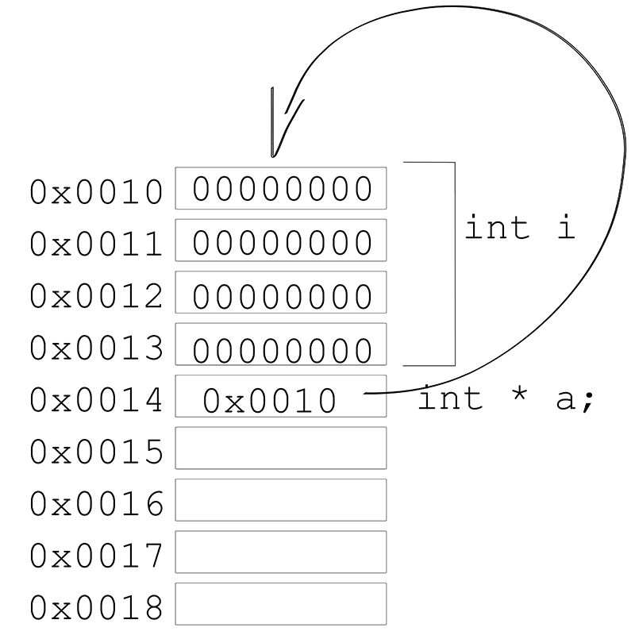
pi
int i;
int *pi =& i ;

Slide 32
Variable name
address
value
int x = 2;
int *px = &x;
X
1000
2
pX
1500
1000
Variable name | Variable type | Address in memory | value
x | int | 1000 | 2
px | Pointer to int | 1500 | 1000

Slide 33
Classes in C++
A user defined type
Consists of both data and methods
Defines properties and behavior of that type

Slide 34
Class definition in C++
#include <iostream>
#include <bits/stdc++.h>
using namespace std;
class GfG
{
public:
int val;
void show( ) {
cout << "Value: " << val ;
}
};
class className {
access_specifier:
// data member
// member method
} object_names; //optional

Slide 35
Access-Specifier
Private members of a class are accessible only from within other members of the same class.
Protected members are accessible from other members of the same class and from members of their derived classes (subcalsses).
Public members are accessible from anywhere where the object is visible.

Slide 36
Class definition and object creation in C++
#include <iostream>
#include <bits/stdc++.h>
using namespace std;
class GfG
{
public:
int val;
void show( ) {
cout << "Value: " << val << endl;
}
};
int main() {
GfG obj ; // Create Object
obj.val = 10;
obj.show( );
return 0;
}

Slide 37
Constructors in C++
#include <bits/stdc++.h>
using namespace std;
class MyClass {
public:
MyClass( ) {
cout << "Constructor called!";
}
};
int main( ) {
MyClass obj;
return 0;
}
Output
Constructor called!

Slide 38
Classes in C++
class class_name {
access_specifier_1: (private, protected, public)
member1;
access_specifier_2:
member2;
...
} object_names; //optional
class Rectangle
{
private:
int width;
int length;
public:
void set(int w, int l);
int area();
};

Slide 39
Static Data Member
class Rectangle
{
private:
int width;
int length;
static int count;
public:
void set(int w, int l);
int area();
};
Rectangle r1;
Rectangle r2;
Rectangle r3;
count
r1
width
length
r2
width
length
width
length
r3

Slide 40
Example Rectangle class
class Rectangle {
int width, height;
public:
void set_values (int,int);
int area (void);
} rect;
All members of a class declared with the class keyword have private access.
This means any member that is declared before any other access specifier has private access automatically.
Functions can be declared in the class as prototype (signature) only and then defined out of the class

Slide 41
Scope operator (::)
The scope operator (::) specifies the class to which the members (functions) being defined belongs.
Functions defined out of the class should use (::)

Slide 42
Defining functions outside the class and creating objects of the class.
#include <iostream>
using namespace std;
class Rectangle {
int width, height;
public:
void set_values ( int, int);
int area( ) {return width*height;}
};
void Rectangle :: set_values (int x, int y) {
width = x;
height = y;
}
int main () {
Rectangle rect;
rect.set_values (3,4);
cout << "area: " << rect.area();
return 0;
}
Function name set_value in the scope of Rectangle class
Object created
The class is considered as a type, declare objects of it
area: 12

Slide 43
Assignment 12
Write a C++ code that creates a Class student with Id, and name, GPA, allows the user to input the Id, name, Id of three students and then arrange them alphabetically in an array.

Slide 44
#include <iostream>
using namespace std;
struct X {
int a, b ;
int add( );
};
int a = 10;
int X::add ( ) { return a + b; }
int main( ) {
int answer;
X xobject;
xobject.a = 1;
xobject.b = 2;
answer = xobject.add( );
cout << xobject.a << " + " << xobject.b << " = " << answer << endl;
}
You can use the keyword class or struct with the same meaning
Member variables
The priority inside class association is to the variable name in the class members
global variables
Member variables
1+2=3

Slide 45
Constructors can also be declaed outside the class
#include <iostream>
using namespace std;
class Rectangle {
int width, height;
public:
Rectangle (int ,int );
int area ( ) {return (width*height);}
};
Rectangle::Rectangle (int a, int b) {
width = a;
height = b;
}
int main () {
Rectangle recta (3,4);
Rectangle rectb (5,6);
cout << "recta area: " << recta.area() << endl;
cout << "rectb area: " << rectb.area() << endl;
return 0;
}
Creating instance of the class using the constructor that sets values
Both definition and setting values

Slide 46
Overloading constructors
In C++ a constructor can be overloaded with different input parameters:
Different number of parameters and/or parameters of different types.

Slide 47
#include <iostream>
using namespace std;
class Rectangle {
int width, height;
public:
Rectangle ( );
Rectangle (int,int);
int area (void) {return (width*height);}
};
Rectangle::Rectangle ( ) {
width = 5;
height = 5;
}
Rectangle::Rectangle (int a, int b) {
width = a;
height = b;
}
int main () {
Rectangle recta (3,4);
Rectangle rectb;
cout << "recta area: " << recta.area() << endl;
cout << "rectb area: " << rectb.area() << endl;
return 0;}
Two different constructors
First with no input parameters
second with two integers
Output:
recta area: 12 rectb area: 25

Slide 48
Different ways to call constructor
class_name object_name ( initialization_value) ;
class_name object_name = initialization_value;
class_name object_name { value, value, value, ... }
class_name object_name = { value, value, value, ... }

Slide 49
Creating objects from class in different ways
#include <iostream>
using namespace std;
class Circle {
double radius;
public:
Circle(double r) { radius = r; }
double circum() {return 2*radius*3.14159265;}
};
int main () {
Circle c1 (10.0);
Circle c2 = 20.0;
Circle c3 {30.0};
Circle c4 = {40.0};
cout << “c1 circumference: " << c1.circum() << '\n';
return 0;
}

Slide 50
Pointers to classes
Objects can also be pointed to by pointers: Once declared, a class becomes a valid type, so it can be used as the type pointed to by a pointer.
class Rectangle {
int width, height;
public:
Rectangle (int,int);
int area () {return (width*height);}
};
Rectangle * rectp;
rectp is a pointer to an object of class Rectangle

Slide 51
#include <iostream>
using namespace std;
class Rectangle {
int width, height;
public:
Rectangle(int x, int y) : width(x), height(y) {}
int area(void) { return width * height; }
};
int main() {
Rectangle recobj (3, 4);
Rectangle * recpt1, * recpt2;
rectp1 = & recobj;
rectp2 = new Rectangle (5, 6);
cout << “first area: " << recobj.area() ;
cout << “first area: " << rectp1->area() ;
cout << “second area " << rectp2->area() << ;
delete rectp2;
return 0;
}
Use keyword new when constructing pointers to objects

